Slide 1


Library management system GROUP-4 CSE-C

Slide 2
CONTENT:-
Aim
Introduction
acknowledgement
Benefits of library management system
Topics discussed
Flow chart
Result / output
Conclusion

Slide 3
Aim
To develop a software that will help user to maintain the digital record of library management for making easy to librarians to search books in the library.
The aim of library management is to efficiently organize, maintain, and provide access to a collection of resources for users, ensuring optimal utilization, preservation, and dissemination of knowledge while meeting the needs of its patrons.

Slide 4

INTRO :
A library management system (LMS) is a software solution designed to automate and streamline various library operations. It encompasses functions like , circulation, acquisition, and patron management
LMS facilitates tasks such as book tracking, membership management, inventory control, and enables patrons to search and access library resources efficiently.
It aims to enhance user experience, improve administrative efficiency, and ensure proper organization and maintenance of library collections.

Slide 5
ACKNOWLEDGEMENTS
This implementation of a library management system in C++ draws inspiration from various programming paradigms and incorporates fundamental concepts such as abstraction, inheritance, encapsulation, polymorphism, and the use of standard library functions .
I would like to express gratitude to the broader C++ programming community and the contributors whose insights and tutorials have contributed to shaping my understanding of these programming concepts. Additionally, I acknowledge the foundational knowledge gained from various educational resources, textbooks, and online tutorials that have helped in conceptualizing the structure and functionalities of this code.

Slide 6
BENIFITS OF LIBRARY MANAGEMENT
Organization
Efficient Resource Utilization
Data management
Enhanced services
Automation and time saving
Security and control

Slide 7
Functions used :-
Here is a list of all the functions used in the program:
* add_ Book(): Adds a book to the collection.
* search _Book(): Searches for a book by ISBN.
* update _Book(): Updates the quantity of a book.
* delete _Book(): Deletes a book by ISBN.
* search Book By _Author(): Searches for books by author name.
* search Book By _Genre(): Searches for books by genre.
* search Book By Price(): Searches for books within a price range.
* display _Info(): Displays the information of a book (overloaded function).
* get _ISBN(): Returns the ISBN of a book.
* get _Quantity(): Returns the quantity of a book.
* set _Quantity(): Sets the quantity of a book.
* get _Author(): Returns the author of a book.
* get _Genre(): Returns the genre of a book.
* get _Price(): Returns the price of a book.

Slide 8
Topics used in code
Class
Objects
Inheritance
Polymorphism
Encapsulation

Slide 9
Flowchart
Start
Display menu
A
Add a book

Slide 10
B
Search a book
C
Update a book

Slide 11
D
Delete a book
E
Search a book by author name

Slide 12
Search book by genre and prize range
Exit

Slide 13
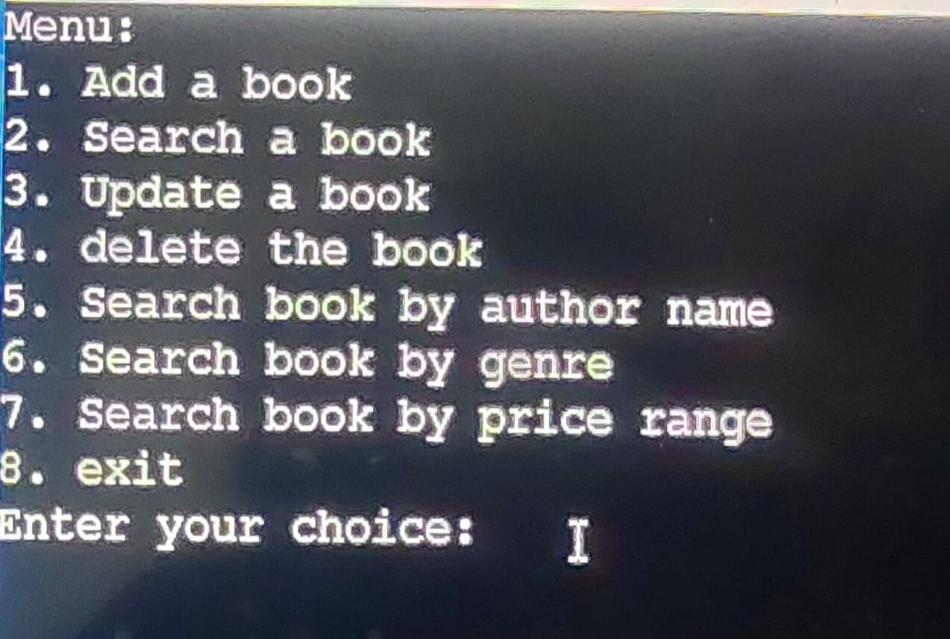
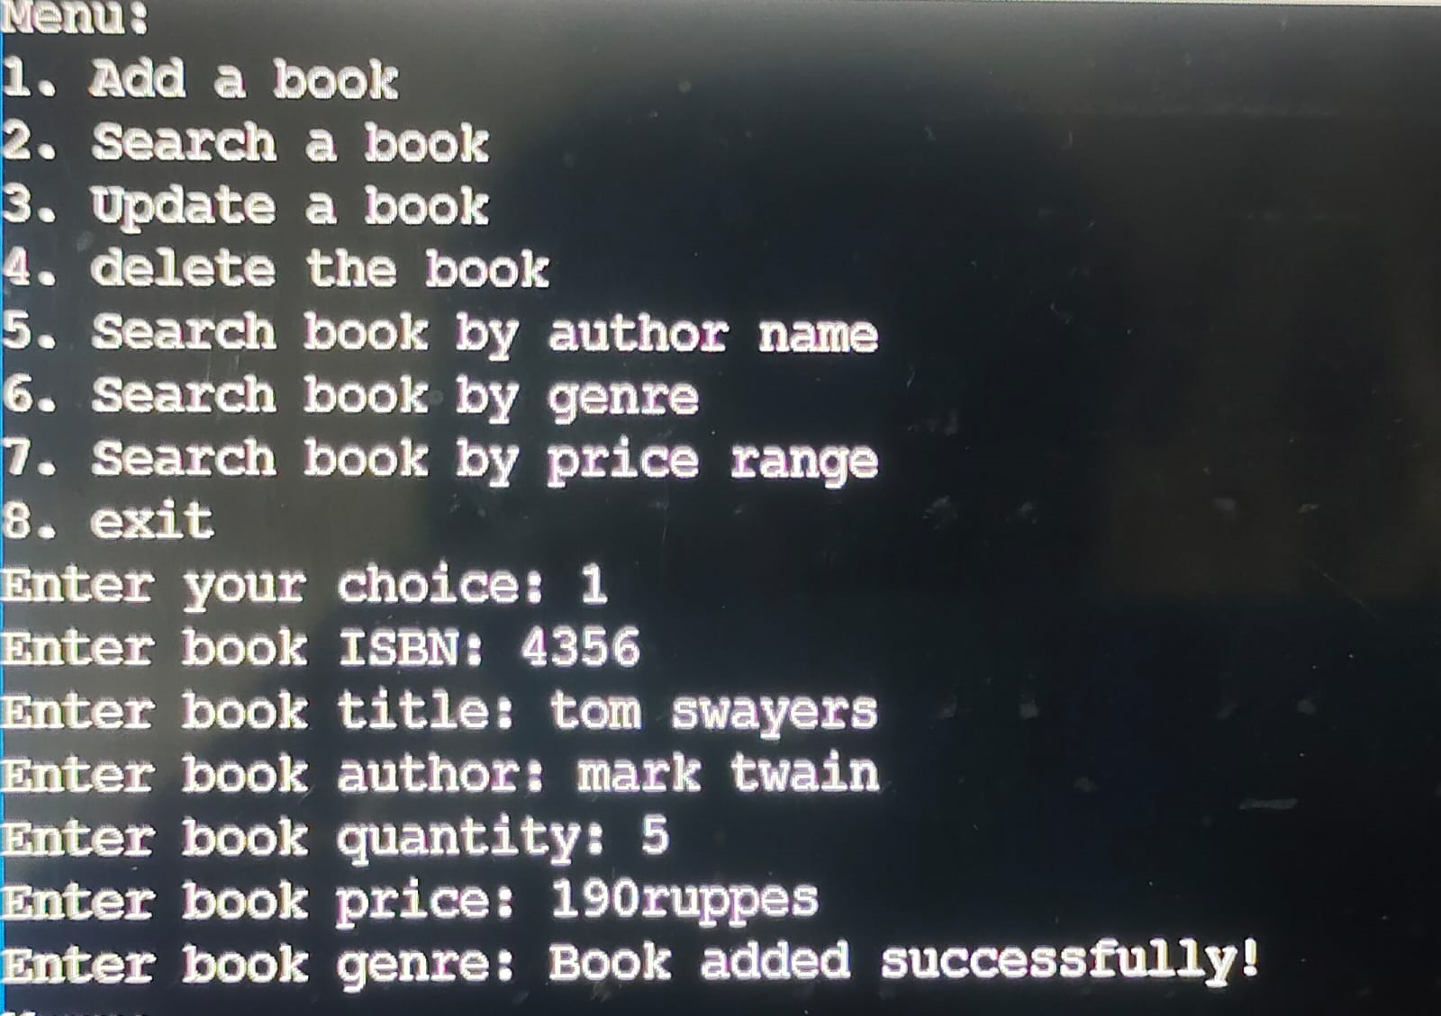
output

Slide 14
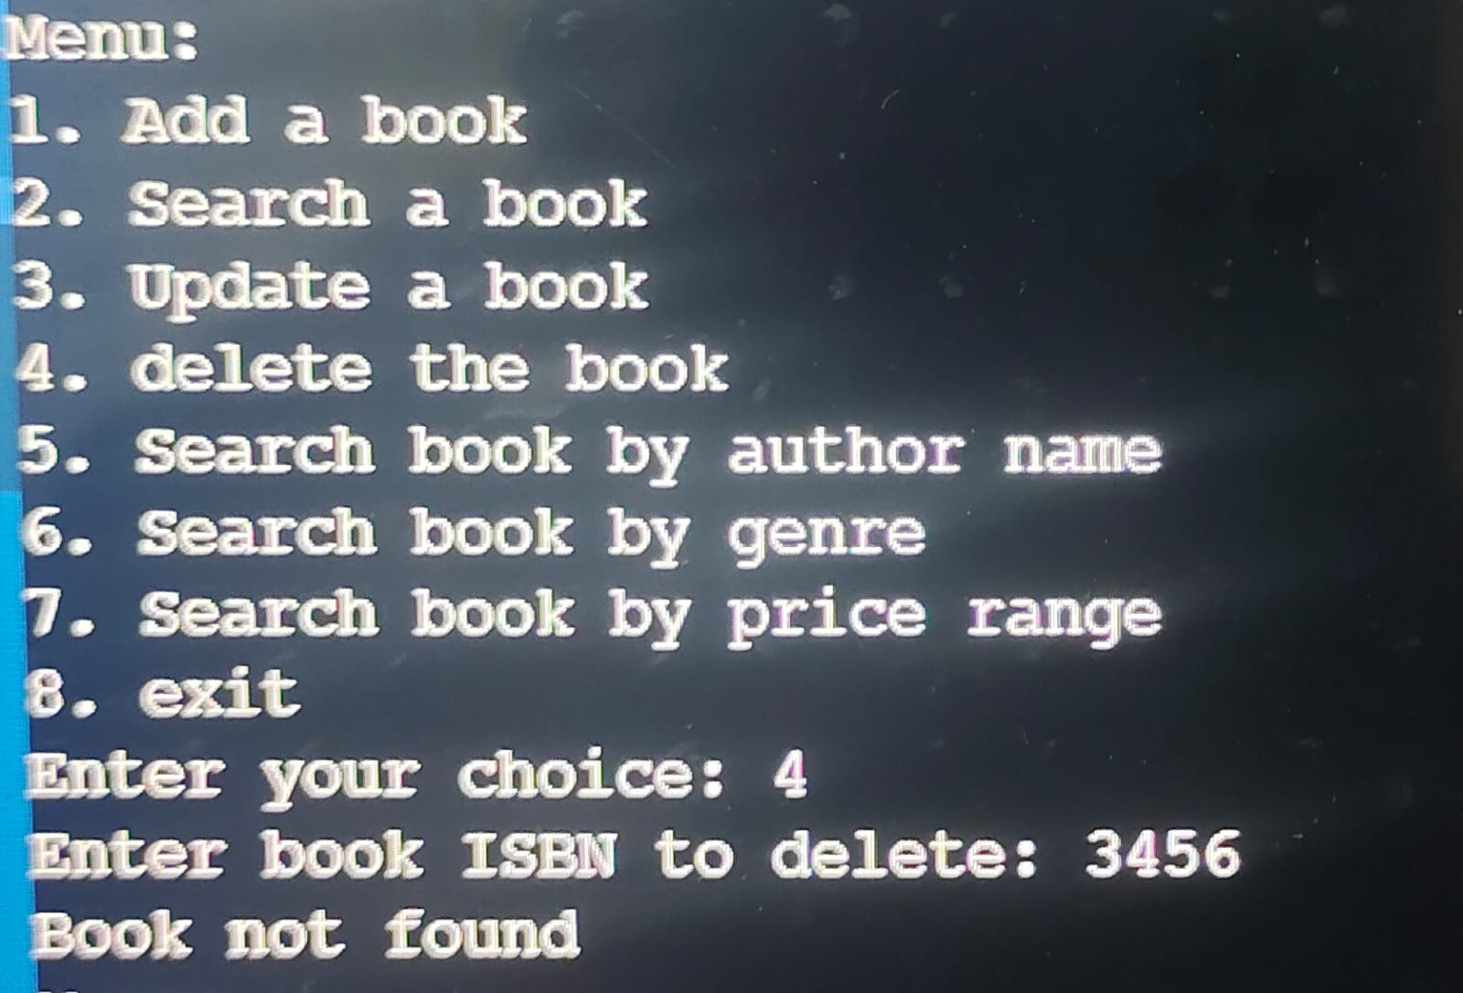
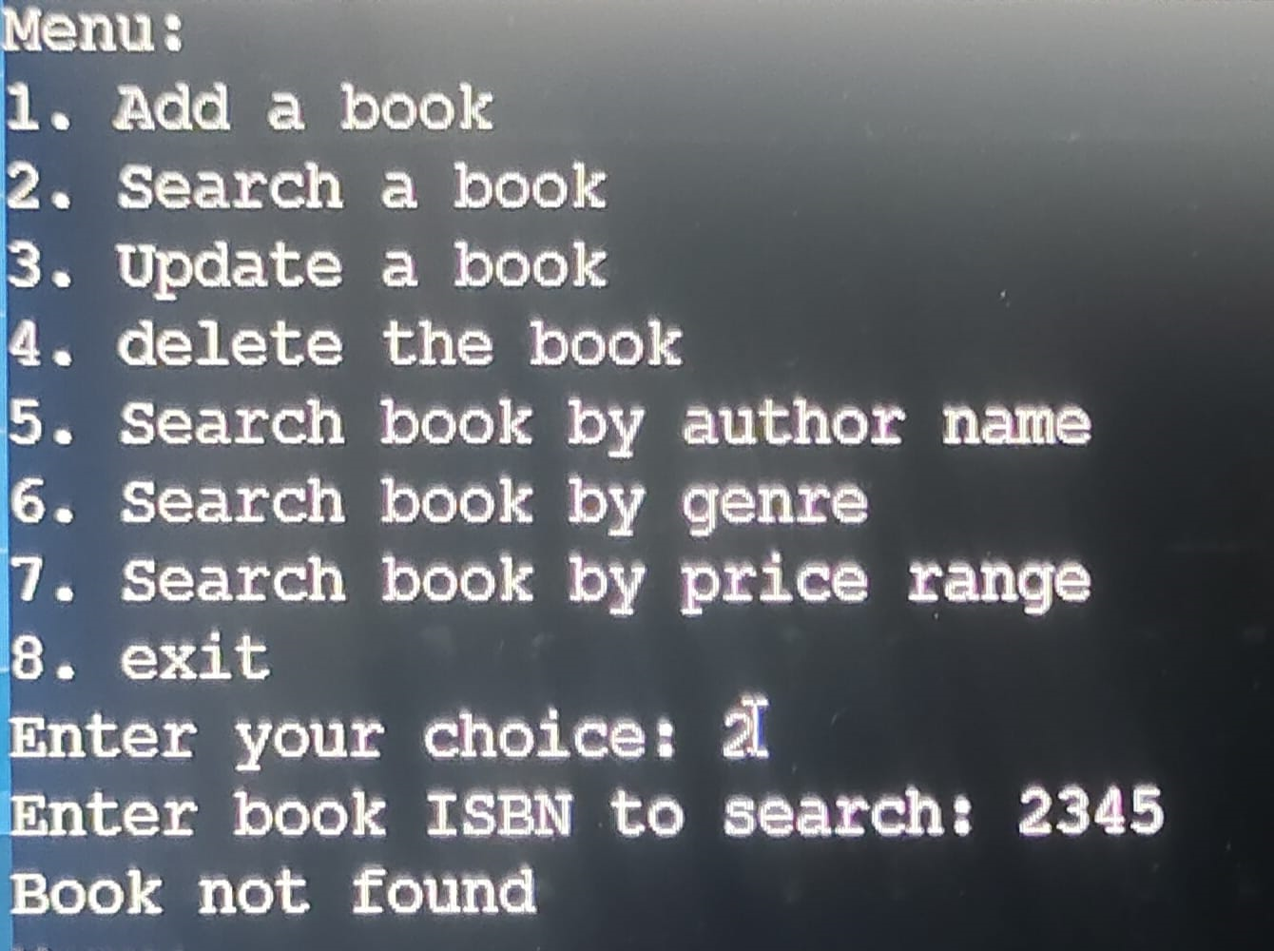
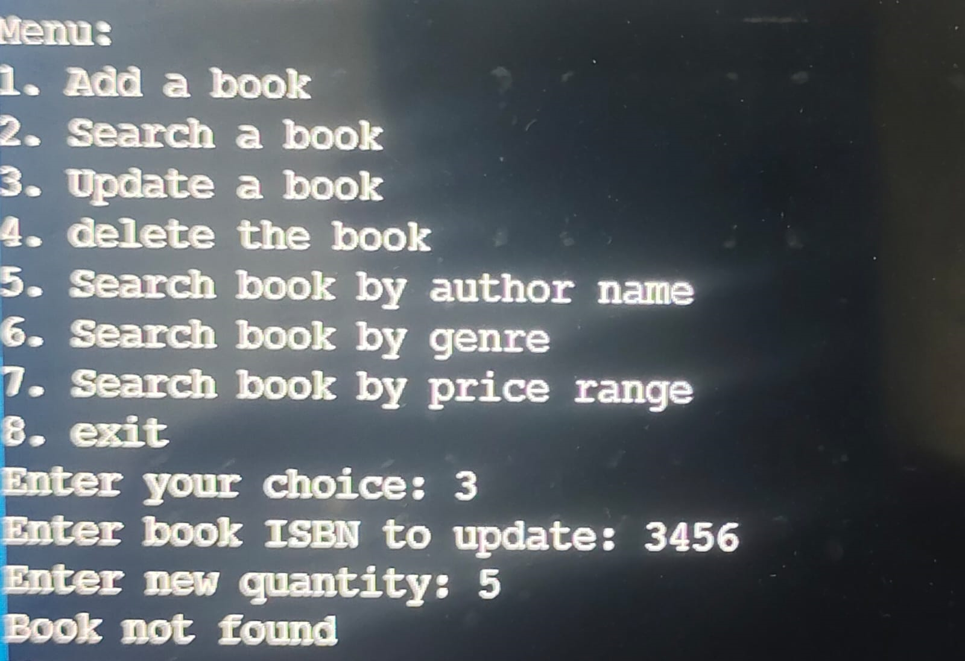
output

Slide 15

Conclusion
The implementation of a library management system ensures efficient organization, retrieval, and management of resources. With its user-friendly interface, comprehensive database, and automation of various tasks, it streamlines library operations, enhances user experience, facilitates resource tracking, and promotes better utilization of library resources.

Slide 16
Thank you
Mithesh-AP22110010195
Anuj - AP22110010165
Kranthi-AP22110010146
Ganesh-AP22110011532

